Slide 1
Control Lec. 2
Transfer Function
References:
Modern control Engineering by OGATA
Automatic control system by KUO.
Control system Engineering by Norman S. Nise.
http://imtiazhussainkalwar.weebly.com
In control theory, functions called transfer functions are commonly used to characterize the input-output relationships of components or systems that can be described by linear, time- invariant, differential equations. We begin by defining the transfer function and follow with a derivation of the transfer function of a mechanical and electrical systems.
Transfer Function: The transfer function of a linear, time-invariant, differential equation system is defined as the ratio of the Laplace transform of the output (response function) to the Laplace transform of the input (driving function) under the assumption that all initial conditions are zero.
Consider the linear time-invariant system defined by the following differential equation:
where y is the output of the system and x is the input
Transfer function = G(s) |
_{G(s)}
Block Diagrams: A block diagram of a system is a pictorial representation of the functions performed by each component and of the flow of signals.
i/p
Transfer function (G(s))
o/p
Fig(2.1) Element of a block diagram

Slide 2
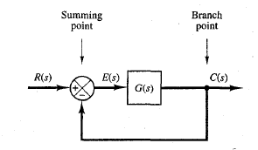
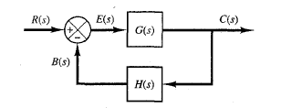
Control Lec. 2
Summing Point: A circle with a cross is the symbol that indicates a summing operation.
a a-b
b
Fig (2.2) Summing point
Branch Point: A branch point is a point from which the signal from a block goes concurrently to other blocks or summing points.
Block Diagram of a Closed-Loop System: Figure (2.3) shows an example of a block diagram of a closed-loop system. The output C(s) is fed back to the summing point, where it is compared with the reference input R(s). The closed-loop nature of the system is clearly indicated by the figure. The output of the block, C(s) in this case, is obtained by multiplying the transfer function G(s) by the input to the block, E(s). Any linear control system may be represented by a block diagram consisting of blocks, summing points, and branch points.
Fig (2.3) Block diagram of a closed-loop system
When the output is fed back to the summing point for comparison with the input, it is necessary to convert the form of the output signal to that of the input signal. This conversion is accomplished by the feedback element whose transfer function is H(s), as shown in Figure (2.4).
Fig (2.4) Closed-loop system

Slide 3
Control Lec. 2
Referring to Figure (2.4), the ratio of the feedback signal B(s) to the actuating error signal
E( s ) is called the open-loop transfer function. That is,
Open-loop transfer function
The ratio of the output C(s) to the actuating error signal E(s) is called the feedforward transfer function, so that
Feedforward transfer function
If the feedback transfer function H(s) is unity, then the open-loop transfer function and the feedforward transfer function are the same.
In Figure (2.4), the output C(s) and input R(s) are related as follows: since
[ ]
2.2 Mathematical Models of System
Mathematical model: The mathematical description of the dynamic characteristics of a system is called mathematical model or mathematical model is the representation of the dynamic behavior of a physical system by a set of equations. The first step in the analysis of a dynamic system is to drive its model.

Slide 4
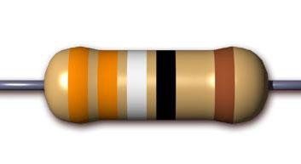
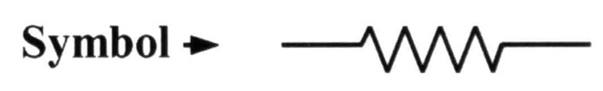

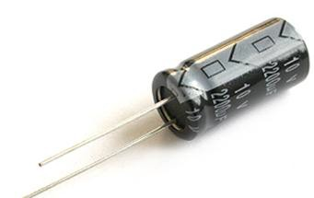

Control Lec. 2
2.2.1 Electric circuits and components
The basic passive elements of electrical systems are resistance, inductance and capacitance.
1--
Resistance
The time domain expression relating voltage and current for the resistor is given by Ohm’s law i-e
The Laplace transform of the above equation is
V_{R} (s) = I_{R} (s)R
2-
The time domain expression relating voltage and current for the Capacitor is given as:
1
v_{c} (t) = ∫ i_{c} (t)dt
C

Slide 5
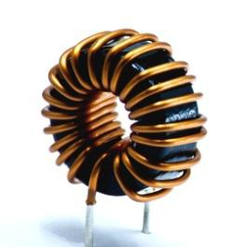

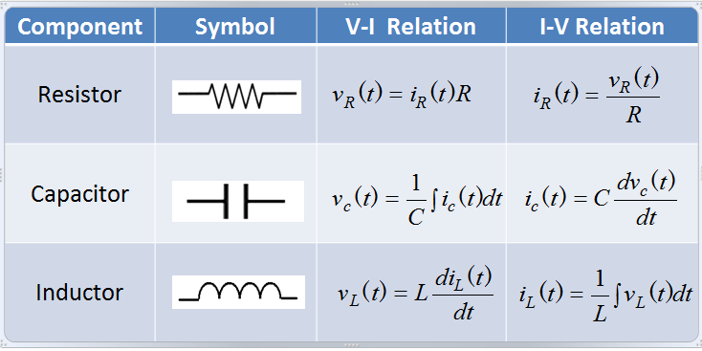
Control Lec. 2
The Laplace transform of the above equation (assuming there is no charge stored in the capacitor) is
V (s) =
1
Cs
I (s)
c
c
3-
The time domain expression relating voltage and current for the inductor is given as:
v
L
_{(t ) = L} di_{L} (t )
dt
The Laplace transform of the above equation (assuming there is no energy stored in inductor) is
V_{L} (s) = LsI_{L} (s)
Table (2.1)

Slide 6

Control Lec. 2
Basic laws governing electrical circuits are Kirchhoff's current law and voltage law, which state:
Sum of currents entering a node is equal to the sum of currents leaving the same node.
The algebraic sum of the voltages around any loop in an electrical circuit is zero.
  A mathematical model of an electrical circuit can be obtained by applying one or both of Kirchhoff's laws to it.
For the series RLC circuit shown below:
i(t)
V(t)
Applying Kirchhoff's voltage law to the system, we obtain the following equations:
∫
… (2.9)
A transfer function model of the circuit can also be obtained as follows: Taking the Laplace transforms of Equation (2.9), assuming zero initial conditions, we obtain
[ ]
If is assumed to be the input and , the output, then the transfer function of this system is found to be

Slide 7
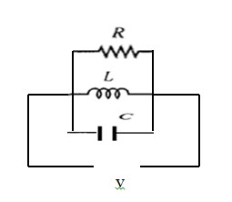
Control Lec. 2
For the parallel RLC circuit shown below:
Applying Kirchhoff's current law to the system, we obtain the following equations:
∫
[ ]
If is assumed to be the input and , the output, then the transfer function of this system is found to be

Slide 8
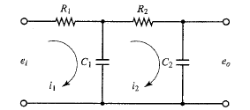
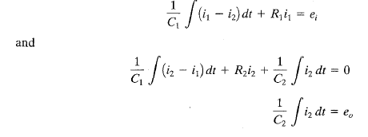
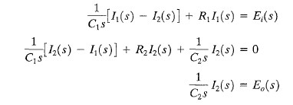

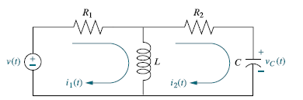
Control Lec. 2
Ex1: Consider the system shown in Figure. Assume that e_{i} is the input and e_{o}, is the output.
The equations for this system are:
Taking the Laplace transforms of Equations, using zero initial conditions, we obtain
(1)
(2)
Eliminating I₁(s) from Equations (1) and (2) and writing Ei(s) in terms of I₂(s), we find the transfer function between Eo(s) and Ei(s) to be
H.W/ Given the network of Figure below , find the transfer function,

Slide 9

Control Lec. 2
2.2.2.1 Mechanical translation system
In this section we shall discuss mathematical modeling of mechanical systems. The fundamental law governing mechanical systems is Newton's second law. It can be applied to any mechanical system. The elements of Mechanical system are mass, spring and dashpot.
1. Mass (M) F
 | Mass
x(t)
a force applied to the mass produce an acceleration of the mass. F_{m} is equal to the product of mass and acceleration.
where a= acceleration
v= velocity
displacement at any time (t)
D-operator =
F_{d}
2. Dashpot
A damping element (sometimes called a dashpot) is assumed to produce a velocity proportional to the force applied to it.
x(t)
where B is damping factor

Slide 10

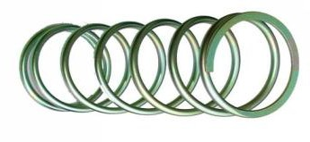
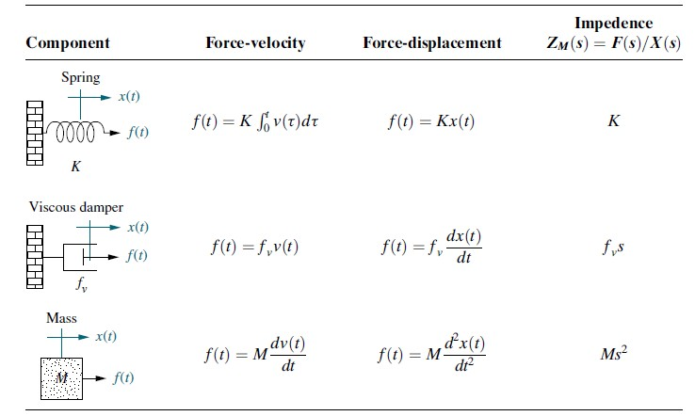
Control Lec. 2
3. Spring: A translational spring is a mechanical element that can be deformed by an external force such that the deformation is directly proportional to the force applied to it.
Circuit Symbols Translational Spring
The elastance, or stiffness k provides a restoring force as represented by a spring
where k is elastance of spring
TABLE 2.2 Force-velocity, force-displacement, and impedance translational relationships for springs, viscous dampers, and mass
Page 10

Slide 11



Control Lec. 2
Mechanical systems parallel electrical networks to such an extent that there are analogies between electrical and mechanical components and variables. Mechanical systems, like electrical networks, have three passive, linear components. Two of them, the spring and the mass, are energy-storage elements; one of them, the viscous damper, dissipates energy. The two energy-storage elements are analogous to the two electrical energy-storage elements, the inductor and capacitor. The energy dissipater is analogous to electrical resistance.
Ex 1: Find the transfer function X₂(s)/F(s) of the following system
x₂
x₁
k
B
F
M
The Mechanical Network of this system is
x₁
k
x₂
At node x₁
F = k(x₁ − x₂ )
(1)
F
↑
M
B
At node x₂
0 = k(x₂ − x₁ ) + Mx₂ + Bx₂
(2)
Taking Laplace transfer for equations 1& 2
[ ]
From equation (3)
(5)
(6)

Slide 12




Control Lec. 2
Substitute equ. (6) in (5)
[ ] [
]
[ ]
[ ]
[ ]
[ ]
Ex 2: Write the differential equation for the system
x₁
x₂
k
M₁
B₃
M ₂
B₄
f (t )
B₁
B₂
The Mechanical Network of this system is
x₁
B₃
x₂
f (t ) ↑
k
M
1
B₁
B₂
M
2
B₄

Slide 13

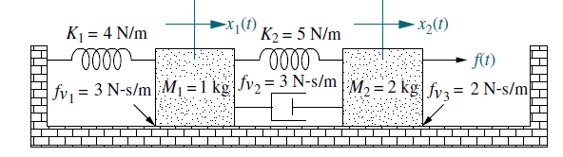
Control Lec. 2
At node x₁
̈ ̇ ̇ ̇
At node x₂
̈ ̇ ̇ ̇ ̇ ̇
H.W 1: Find the transfer function X₁(s)/F(s) of the following system
H.W 2: Find the transfer function X₁(s)/F(s) of the following system

